Slide 1
Connections with Care
Emergency medical transportation solutions
MASA 2024 | Confidential

Slide 2
20+ sources
25,000 datapoints
Campaign results
Purchase history
MASA is 50!
Founded in 1974 as Medical Air Services Association, Inc. and celebrating its 50th anniversary, MASA® continues to expand on its mission to connect members with critical care. As a global organization with 17 international locations and coverage in all 50 states and Canada, MASA serves more than 2 million members with emergency and non-emergency transportation benefits and so much more. Learn more at masaaccess.com.

Slide 3
A growing issue: Medical transportation
1 in 4
35%
105
families require an ambulance every 3 years¹
increase in ride costs over the last 5 years¹
hospital closures in the U.S. 2018–2021²
1: Milliman data compiled in Dec. 2023
2: Cherrystone Hill Consulting, 2024
Notes:
MASA’s mission statement: "Protecting families with compassion when other don’t”
Employees shouldn’t have to decide whether to be transported or not based on the cost of those transports.
Worry over the cost of ambulance transport too often results in delay in treatment, leading to untreated, long-term complications.
For an employer, this can mean extended hospital stays in hospitals or outpatient treatments – a silent, but significant contributor to group rates.
With MASA in place, we are the solution for the members regardless of how the medical department settles the claim.
1 in 4 families experience a need for emergency transportation every 3 years
The cost of ambulance rides is far outpacing inflation
And hospital closures are limiting critical access to care

Slide 4
A growing issue: Medical transportation
1 in 2
70+
300
caretaking families require an ambulance every 3 years¹
The "Silver Tsunami” means 11.5% of the workforce will be age 70+ by 2030²
hospitals at immediate risk of closure³
1: MASA claims data compiled in Jan. 2024
2: Bureau of Labor Statistic, U.S. Department of Labor, 2024
3: Cherrystone Hill Consulting, 2024
Notes:
1 in 2 caretaking families require an ambulance every 3 years - this is twice as often as the average family
If you think this isn’t relevant for employees today, consider…
1 in 6 working adults is in a caregiving role…
With more workers in the sandwich generation than ever – taking care of their children and parents at the same time.
Combine this with an upward trending average age in the workforce…
And the 300 hospitals nationwide at immediate risk of closing…
And we have a serious access to care issue for our employees

Slide 5
Why MASA matters to today’s workforce
The average ground ambulance bill is $2,008.¹
Costly bills have become a normal, expected part of emergency care — even for the insured.
60% of Americans have to borrow just to cover a $1,000 health expense.²
94% of employees don’t know that there’s a solution that will cover ambulance bills.³
When employees learn there’s a solution like MASA,
30% are likely to pay for it.³
1: Consumer Reports, 2021
2: Bankrate, February 2023
3: Independent McKinsey Report, 2019
Notes:
Big picture…
The average ground ambulance bill is just over $2,000
60% of Americans need to borrow to cover a $1,000 expense
When employees learn there’s a solution like MASA, 30% are likely to pay for it.

Slide 6
The MASA solution
The simple solution to a complex problem for millions of employees.
Studies indicate a strong group benefits program is key to achieving employee retention and plan participation goals. MASA supports these goals by mitigating employee stress and uncertainty while encouraging member wellness.
The numbers speak for themselves: our 38% participation rate across groups proves that for employees — this is a problem worth solving.¹
MASA guarantees:
No Social Security numbers needed
No health questions
No claim forms
No network limitations
No deductibles
No denials based on claim cost
1: MASA Internal Data, Updated February 2023
Notes:
We all know the standard health, dental, vision, life benefit program doesn’t cut it anymore
Studies show holistic, thoughtful, and meaningful benefit programs positively impact employee health, wellness, retention, and recruiting efforts.
Understanding the modern challenges faced by employees today is key to remaining your clients’ trusted risk management advisor and we’re here to help!
Our participation rates speak for themselves – financial protection is valuable and critical to today’s workforce.
MASA makes it easy with…
No SSN
No health questions
No claim forms
No network limitations
No deductibles
No denials based on claim cost

Slide 7
How does it work?
Employees choose a plan when they enroll.
Members have access to coverage for any ambulance provider, nationwide.
MASA can be used to cover any emergency transportation situation and does not need to be triggered by a specific event.
Medical transport claims are covered — including deductibles, co-insurance, co-pays, denied claims, and balance bills.
Notes:
How do MASA plans work?
Employees select from the employer-offered plans during open enrollment
Coverage applies to any ambulance provider, nationwide – no network limitations
No specific triggering event is needed – MASA can be used to cover any emergency medical transportation situation
Medical transport claims include deductibles, co-insurance, co-pays, denied claims, and balance bills.

Slide 8
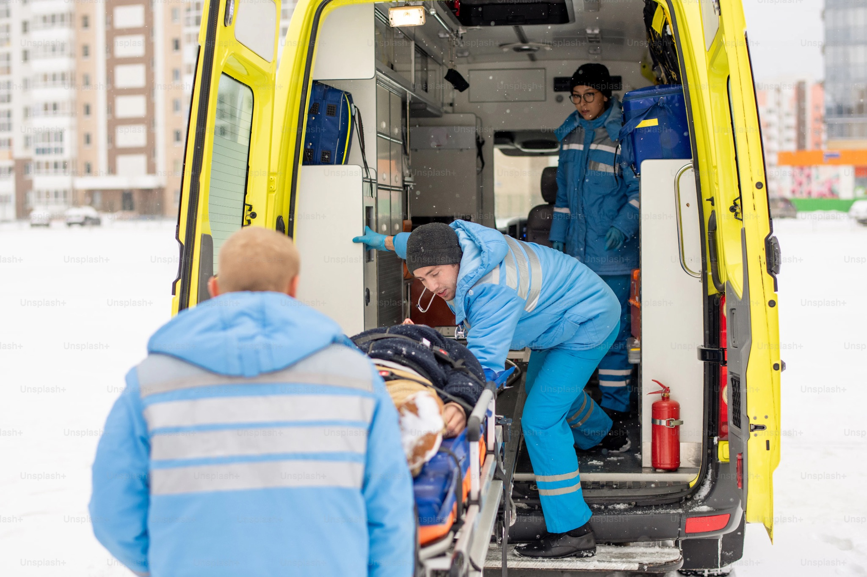
Who benefits from this coverage?
Groups offering high deductible health plans
Employees and families who travel
Groups with aging populations
Employees expecting emergency transportation needs or those with chronic illness
Families involved in sports and extracurricular activities
and more!
Notes:
MASA offers protection for several key markets…
Employees enrolled in HDHPs and other plans with higher deductibles can utilize MASA when deductibles and coinsurance limits have not been met
Employees who travel often for work or pleasure
Employees with families who travel
Especially those involved in sports and extracurricular activities
Groups with aging populations
Groups or employees expecting emergency transportation needs or those with chronic illness
This can be a great tool for groups mitigating rate increases with increased deductibles and coinsurance plans

Slide 9
MASA covers all financial exposures related to medical transportation
Did you know?
28M
emergency transports dispatched by 911 every year¹
Nearly every
1 second
A ground ambulance is dispatched in the U.S.¹
Nearly every
1 minute
An air ambulance is dispatched in the U.S.²
21K
licensed ground ambulance providers in the U.S.
300
air medical providers in the U.S.
MASA provides a simple response to a complex industry with an no network model where one does not exist today.
1: National Association of State EMS Officials, 2020
2: National Association of Insurance Commissioners, 2022
Notes:
Did you know…
The average ambulance bill includes 24 or more codes – it’s not just a bill for the ride itself (Milliman data compiled January 2024)
These codes include services provides during the transport and can include things like…
Life support services
Disposable supplies
IVs
Oxygen monitoring
And more
MASA covers costs like these and more
And unlike every other medical transport coverage solution out here – we have no network retrictions.
We cover all 21k ground ambulance and 300 air medical ambulance providers in the U.S.
We want our members calling 9-1-1, not searching for an in-network provider in their time of need.

Slide 10
Ground ambulance is not covered by NSA, exposing employees to financial insecurity
The No Surprises Act (NSA) does not include ground ambulance services. Yet, ground ambulance services are among the most common sources of out-of-network bills and can cost consumers thousands of dollars.
79% of all ground ambulance rides could result in an out-of-network bill.
No Surprises Act
WHAT’S IMPACTED?
$9,100
out-of-pocket limit for an individual plan
$18,200
out-of-pocket limit for a family plan
Consumer Reports, 2021
Maximum out-of-pocket for ACA-compliant group benefits plans; U.S. Department of Health and Human Services, January 2023
Notes:
If you think the No Surprises Act has your due diligence covered – think again.
NSA does not include ground ambulance services.
And yet they are among the most common sources of out-of-network bills
79% of ground ambulance rides could result in an out-of-network bill
With a max out-of-pocket limit of $9,100 for ACA-compliant benefit plans…
this leaves employees at critical risk for large bills in the aftermath of a medical emergency
NOTE: Providers of air ambulance services can no longer “balance bill” an individual for an amount that exceeds federally mandated in-network limits of ACA-complaint group benefits plans

Slide 11
Protecting families
with compassion when others don’t.
By offering MASA, you can help bridge the high-cost exposures in emergency medical transport while adding real value to healthcare plans.
Notes:
MASA’s mission is “protecting families with compassion when others don’t.”
We see this financial exposure left by major medical day after day in the testimonials we receive from our members.
With MASA, you can feel confident you are adding real value and piece of mind to your employee benefit programs

Slide 12
MASA in the employee benefits space
The need for MASA is reflected in high voluntary participation rates:
MASA’s medical-transport coverage is easily bundled with core health benefits — enabling brokers to provide clients the comprehensive supplementary benefits package that today’s employees are seeking.
39%
case size <250
>700
benefits broker
& consulting groups
>3K
group benefits clients to date
95%
group persistency
19%
case size 250-1K
13%
case size 1K-5K
MASA internal data, 2024
5%
case size 5k+
Notes:
MASA is easily bundled with core health benefits – offering a more comprehensive benefits program
We work with…
Over 700 broker and consulting groups nationwide
More than 3,000 groups
With a 95% group persistency rate

Slide 13
At our core
MASA |  | Health Insurance
 | Complete ground and air ambulance coverage Any dispatched ambulance used by the member for emergency services is covered – ground or air.
 | Specialized transport coordination MASA uniquely arranges for and covers select ambulance transport and services ancillary to the ambulance ride
 | Provider negotiation services Advanced provider negotiation expertise ensures all ambulance charges are correct
 | Claims team focused on paying, not denying Claims are compensated, including deductibles, co-insurance, co-pays, and balance bills
Notes:
MASA offers protection where major medical falls short.
All of our plans offer our core benefits…
Ground and air ambulance coverage
Specialized transport coordination
Provider negotiation services
Dedicated claims support team

Slide 14
NEW!
Essentials Plan
A low-price, high-value gateway product for large cases.
Essentials Plan benefits¹
Ground Ambulance Transportation
Air Ambulance Transportation
Hospital to Hospital Transportation
Who’s it for?
Employees of employers 5k+
Employer paid coverages
Ability to upgrade product
1: United States only.
This material is for informational purposes only and does not provide any coverage. The benefits listed, and the descriptions thereof, do not represent the full terms and conditions applicable for usage and may only be offered in some memberships or policies. Premiums and benefits vary depending on the benefits selected. For a complete list of benefits, premiums, and full terms, conditions, and restrictions, please refer to the applicable policy for your state and territory.
Notes:
Essentials is an employer-paid product, available for groups of 5,000 or more, and is offered to employees alongside a buy-up option – typically Premier.
Essentials was created in response to the need for a high-value, low-cost, “gateway” product offering essential protection for groups with high-value employee benefit programs.
In addition to our core benefits, Essentials includes…
Ground transport capped at $750
Air transport capped at $750 , and
Hospital-to-hospital transport. capped at $7,500
The positioning of this is extremely and can be built into the contribution strategy of the medical plan, making it budget-neutral for the employer.
And increased value with buy up options for the members!

Slide 15
Emergent Plus Plan
The leading solution for complete peace of mind.
Emergent Air Transport²
Coverage for all providers in all 50 states and Canada for both emergent air transports from a scene and emergent interfacility.
Emergent Ground Transport²
Transports by all providers in all 50 states and Canada are covered.
Non-Emergent Hospital to Hospital²
If the member needs to be transported to another hospital for higher level of care that is not immediately life-threatening, MASA arranges the transport.
Repatriation²
If the member expected to be hospitalized for an extended period more than 100 miles from home, MASA can arrange for a transport back to a hospital closer to home.
2: United States, Canada.
Notes:
Emergent Plus includes our core benefits and…
Ground transport
Air transport
Hospital-to-hospital transport
Repatriation

Slide 16
NEW!
Emergent Premier Plan
Feature-rich plan to meet the health needs of today's workforce.
All Emergent Plus Benefits²
Includes all the Emergent Plus benefits with extended repatriation benefits³.
Sick While Away from Home Expense Protection⁴
Protection of up to $5,000 per year of expenses related to a covered emergency while traveling.
Minor Return³
If a minor is left unattended while traveling due to illness or injury of a member, MASA will arrange for transport to a guardian.
Post-Admission Continued Care Transportation Coverage¹
Expense assistance for non-emergent transportation from the hospital to rehab, skilled nursing, long-term care, or back home.
Pet Return³
MASA can arrange to transport domestic pets back to the closest commercial airport to member’s primary address.
1: United States only. 2: United States, Canada. 3: United States, Canada, Mexico, the Caribbean (excluding Cuba), the Bahamas and Bermuda. 4: Worldwide coverage to include any region with the exclusion of Antarctica and not prohibited by U.S. law or under certain U.S. travel advisories as long as the member has provided ten (10) day notice.
Notes:
Emergent Premier includes our core benefits, all of the Emergent Plus benefits and…
Sick white away from home protection
Minor, child, or grandchild return
Post-admission continued care transportation coverage
Pet return

Slide 17
NEW!
Emergent Premier Plan
Feature-rich plan to meet the health needs of today's workforce.
Emergent Air Transport²
Coverage for all providers in all 50 states and Canada for both emergent air transports from a scene and emergent interfacility.
Emergent Ground Transport²
Transports by all providers in all 50 states and Canada are covered.
Non-Emergent Hospital to Hospital²
If the member needs to be transported to another hospital for higher level of care that is not immediately life-threatening, MASA arranges the transport.
Repatriation³
If the member expected to be hospitalized for an extended period more than 100 miles from home, MASA can arrange for a transport back to a hospital closer to home.
Pet Return³
MASA can arrange to transport domestic pets back to the closest commercial airport to member’s primary address.
Minor Return³
If a minor is left unattended while traveling due to illness or injury of a member, MASA will arrange for transport to a guardian.
Sick While Away from Home Expense Protection⁴
Protection of up to $5,000 per year of expenses related to a covered emergency while traveling.
Post-Admission Continued Care Transportation Coverage¹
Expense assistance for non-emergent transportation from the hospital to rehab, skilled nursing, long-term care, or back home.
1: United States only. 2: United States, Canada. 3: United States, Canada, Mexico, the Caribbean (excluding Cuba), the Bahamas and Bermuda. 4: Worldwide coverage to include any region with the exclusion of Antarctica and not prohibited by U.S. law or under certain U.S. travel advisories as long as the member has provided ten (10) day notice.
Notes:
Emergent Premier includes our core benefits, all of the Emergent Plus benefits and…
Sick white away from home protection
Minor, child, or grandchild return
Post-admission continued care transportation coverage
Pet return

Slide 18
Platinum Plan
A high-value plan for comprehensive coverage. Ideal for executive carveout packages.
All Emergent Plus Benefits²
Includes all the Emergent Plus benefits with the repatriation benefits coverage extending worldwide⁴.
Organ Transplant Transportation¹
In the event the member needs an organ transplant, MASA will arrange transport to or from member.
Minor Return³
If a minor is left unattended while traveling due to illness or injury of a member, MASA will arrange for transport to a guardian.
Return Transportation⁴
If more than 100 miles away and hospitalized for at least 24 hours, upon being discharged, MASA can purchase a plane ticket home.
Pet Return³
MASA can arrange to transport domestic pets back to the closest commercial airport to member’s primary address.
Companion Transportation³
MASA can arrange for a family member or friend to accompany member during transport.
Mortal Remains Return⁴
If more than 100 miles from home, MASA can arrange and pay for the transport of the remains to the closest airport to member’s residence.
Vehicle Return³
If the member is unable to drive their vehicle home due to illness or injury, MASA will arrange to bring the vehicle back to the member’s residence.
Visitor Transportation³
If hospitalized for 7 days or longer, MASA will arrange for the transport of a family member or friend to the closest airport to where member is hospitalized.
1: United States only. 2: United States, Canada. 3: United States, Canada, Mexico, the Caribbean (excluding Cuba), the Bahamas and Bermuda. 4: Worldwide coverage to include any region with the exclusion of Antarctica and not prohibited by U.S. law or under certain U.S. travel advisories as long as the member has provided ten (10) day notice.
Notes:
Our Platinum plan includes all of our Emergent Plus benefits and….
Organ transplant transportation
Minor, child or grandchild return
Return transportation
Pet return
Companion transportation
Mortal remains return
Vehicle return
Visitor transportation

Slide 19
MASA at work Ground & air ambulances
“
I can say that I was able to focus on the healing of my child as I knew MASA would handle the rest.
I never had to worry about calling MASA to see if this was paid. Never had to answer a million questions as to what happened and if this was a covered expense.”
— Ashley, MASA member
Most people never think they’ll need emergency transport
Ashley’s young son experienced breathing complications due to a lung condition that required a transfer via rotary ambulance to an advanced facility where medical specialists could treat her son.
Focusing on your child when it matters most
Ashley never had to worry or fight for the payment of the bills associated with her son’s emergency transport need. MASA paid the total leaving Ashley with a $0 outcome.
Notes:
(Real MASA ground and air ambulance claim examples)

Slide 20
MASA at work Multiple ground ambulances
“
After several days being at home, the bills started arriving — two ambulances trips, medical procedures at two hospitals, and my return trip home. The folks at MASA advised they would review the claims, and the decision was that they would cover the total cost. Without the MASA membership, I would have had to finance the payments for the ambulance trips for some time.”
— Paul, MASA member
Cardiac episode at work
After driving to an urgent care clinic, Paul was transferred to a local hospital for symptoms of cardiac arrest. Once he was examined, the doctor ordered a transfer to advanced facilities for life-saving treatments.
Two ambulance trips, medical procedures, and two hospitals
Paul submitted his medical transport bills to MASA after his return home. The total of his multiple ambulance transport costs was covered in full, leaving Paul with a $0 outcome.
Notes:
(Real MASA ground ambulance claim examples where multiple ambulances were needed)

Slide 21
MASA by the numbers
2M+
members
500+
team members
17
international locations
4.8
google review
Notes:
No

Slide 22
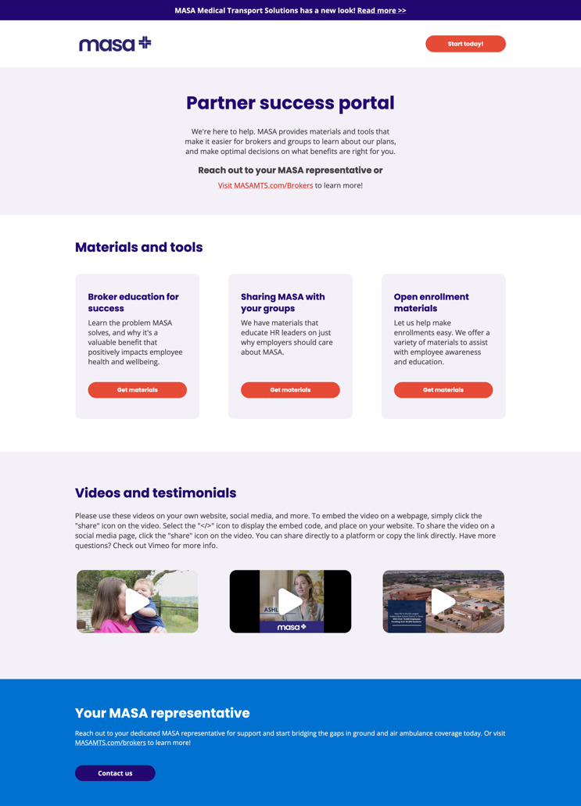
Everything you need to incorporate MASA
Link to broker portal: https://info.masamts.com/masa-mts-broker-success-portal
MASA collateral and presentations
Infographics and industry overviews
Group medical plan transportation coverage gap assessment
Open enrollment resources
Notes:
MASA wants to make your job as easy as possible.
Our broker portal is a powerhouse of information for your brokerage team, your groups, and your groups’ employees
We’re continually updating materials for every stage of your journey with: sales guides, Industry overviews, Info-graphs, product sheets and more
Our transportation coverage gap assessment is an incredible tool to create create a client-specific proposal revealing exposures specific to their health insurance plan offering.
We consider the client’s healthcare plans and premiums and calculate the risk exposures with and without MASA. Let me know if you’d like me to do an analysis for your groups!
Our Open Enrollment asset library and support team are available to your service and marketing teams as well as group HR teams.
This library includes logos, testimonials, website banners, posters, flyers, emails and MASA enrollment language that will flex to your specific needs.
Your MASA Client Services team and myself are available for special requests and on-site enrollment assistance
Our Marketing Team is available for large groups of 1000 and more for custom email campaigns, OE reminder ads, and more.

Slide 23
MASA makes it easy
Enrollment solutions
Dedicated expert
Ease of enrollment across any platform
Implementation professional assigned to each case
No-noise execution
99% groups
Start to finish implementation in as little as 1 week
Retained as MASA clients
Notes:
MASA’s Implementation and Sales Enablement teams ensure that implementations are smooth and seamless for you and your clients.
Implementing our products should not be a heavy lift for your clients, our team takes on most of the tasks.
MASA is there from…
Employer agreement to
Group setup to
Enrollment support to
Communications and marketing support.
We customize our recommendations based on enrollment goals, BenAdmin platform, and how employees take in benefit education.
We integrate with many of the leading platforms such as - Ease/ Employee Navigator, bswift , and Selerix
We have established playbooks and materials pre-built into those systems to make setup quick and easy.
We also offer direct enrollment through our own systems for those who need it
Our streamlined data implementation process can handle any size employer group with the same quality of service regardless of unique needs.
EDI files are processed within 1 business day of receipt, and manual file processing can be done in as little as 3 days.
If any special circumstances arise, our specialists will respond within 1 business day and any escalated issues will be handled the same day.
Once your groups are up and running, our Client Services team takes over to serve as ongoing support to both you and your client.
Their client satisfaction score is 4.8 out of 5 stars and has been for several years.

Slide 24
MASA makes it easy
A no-noise benefit
Simple employer agreement
Depending on implementation type, we offer a straightforward, 3-page employer agreement.
Enrollment support
MASA can provide enrollment and pre-enrollment support both in person and online.
Streamlined platform integrations
EDI Services Team ensures clean enrollment processing experience with group’s HRIS system.
Ongoing group administration
Ben Admin system file feeds and/or portal access enable changes or view of current or past enrollments.
Notes:
MASA is a no-noise benefit.
We offer a simple employer agreement…
Enrollment support…
Streamlined platform integration…
And easy group administration

Slide 25
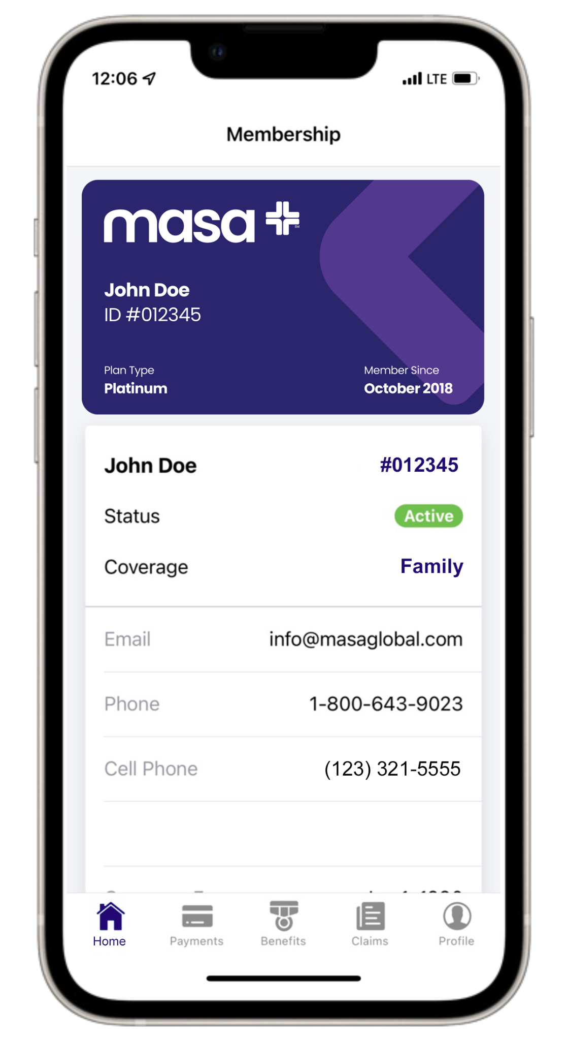
Visuals
App
Monthly email mock (delete "the Benefit")
Feel free to add pic of person enrolling
Compassionate service when it matters most
Compassionate transport services — a team dedicated to assisting when it matters most
Claims team focused on paying, not denying — ready to guide through the process
Easy and convenient self-service tools — online portal, mobile apps to track claim progress
Connections continue through ongoing engagement with enrolled employees with 50%+ digital and app engagement
Notes:
Our white-glove service teams are truly the heart of our operation. Our teams include…
Member services – for everyday support
Claims support – for claims submission and advocacy
Transport services team – for assistance in arranging transportation
Our service teams have a natural talent for compassion and are continuously trained in member support.
With a score of 72, we are proud to rank well above the insurance industry average NPS of 32 NPS.
Members have the 24/7 access they’ve come to expect via online portal and mobile app
Plan information
Support contact information
Claim tracking
Self-service tools

Slide 26
MASA is your go-to solution for large-case clients
The only supplemental benefit of our kind
Huge value add for self-funded clients
All providers are covered – no network needed
No-noise solution in a sea of shallow sales tactics
Notes:
Depend on MASA for protecting your employees’ families when other don’t with our emergency medical transportation solution.

Slide 27
Thank you
Notes:
Thank you!

Slide 28
Did you know?
The state of
Massachusetts has:
580+
7,700+
Licensed EMS agencies³
Square miles to cover for emergency transport⁴
MASA works to ensure access to care when it’s needed most by shielding
members from out-of-pocket costs, regardless of ambulance provider.
^{The average}
ground ambulance ride costs $2,0002
The average medical air transport costs $69,000 per flight2
Ambulance usage in Massachusetts is nearly 3x the national average5
1: MetLife, 2019 | 2: MASA Internal Data, Updated February 2023 | 3: 2020, National Emergency Medical Services Assessment | 4: U.S. Census, 2020 | 5: MASA 2024 analysis: private database of U.S. claims data from 2022

