Slide 1
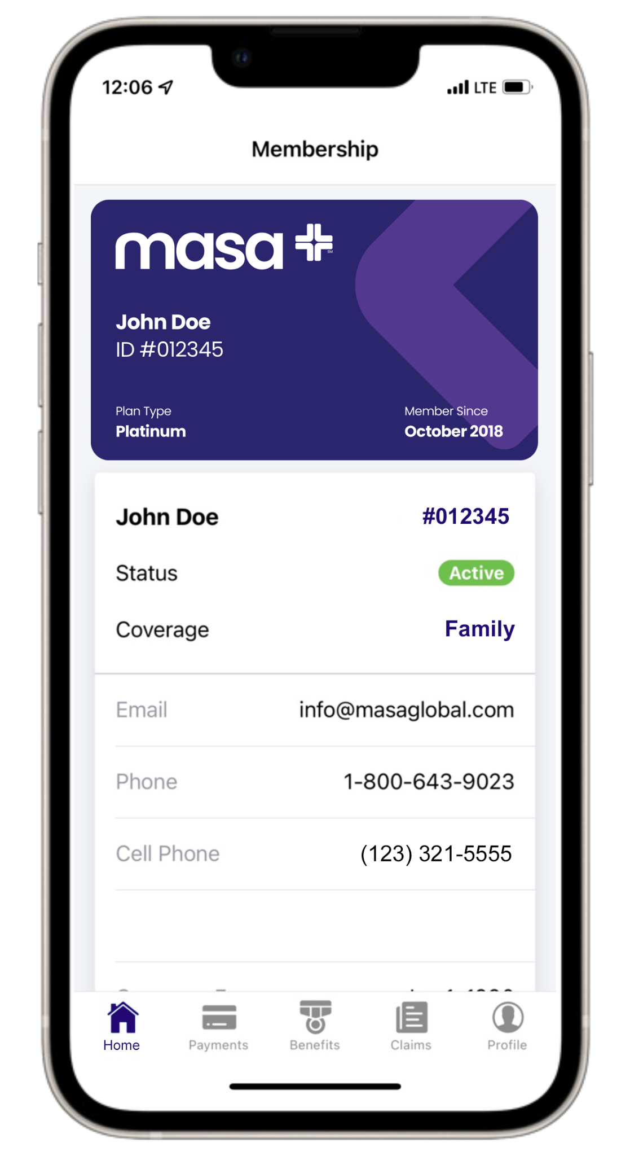
Download the MASA Global app today! Registration is easy with your Member ID
Access your digital ID cards
View plan documents and benefits
View your claims history
MASA 2024 | Confidential

